Slide 1
Covid vaccines Analysis

Slide 2
Introduction
Data visualization helps transform your numbers into an engaging story with details and patterns. Data visualization enables us to recognize emerging trends and respond rapidly on the grounds of what we see.

Slide 3
Program & Output
Importing Libraries:
import numpy as np # linear algebra import pandas as pd # data processing, CSV file I/O (e.g. pd.read_csv) import matplotlib.pyplot as plt import seaborn as sns import plotly.express as px from plotly.offline import download_plotlyjs,init_notebook_mode,plot,iplot import plotly.graph_objects as go import plotly.figure_factory as ff from plotly.colors import n_colors from wordcloud import WordCloud,ImageColorGenerator init_notebook_mode(connected=True) from plotly.subplots import make_subplots from pywaffle import Waffle import warnings warnings.filterwarnings("ignore

Slide 4
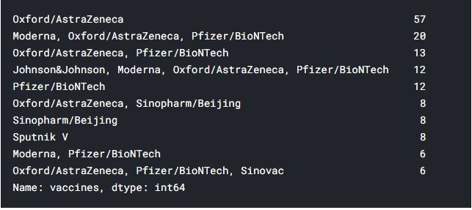
Reading the Data:
top10 = new_df['vaccines'].value_counts().nlargest(10) top10

Slide 5
data = dict(new_df['vaccines'].value_counts(normalize = True).nlargest(10)*100) #dict(new_df['vaccines'].value_counts(normalize = True) * 100) vaccine = ['Oxford/AstraZeneca', 'Moderna, Oxford/AstraZeneca, Pfizer/BioNTech', 'Oxford/AstraZeneca, Pfizer/BioNTech', 'Johnson&Johnson, Moderna, Oxford/AstraZeneca, Pfizer/BioNTech', 'Pfizer/BioNTech', 'Sputnik V', 'Oxford/AstraZeneca, Sinopharm/Beijing', 'Sinopharm/Beijing', 'Moderna, Pfizer/BioNTech', 'Oxford/AstraZeneca, Pfizer/BioNTech, Sinovac'] fig = plt.figure
rows=7, columns=12, FigureClass = Waffle, values = data, title={'label': 'Proportion of Vaccines', 'loc': 'center', 'fontsize':15}, colors=("#FF7F0E", "#00B5F7", "#AB63FA","#00CC96","#E9967A","#F08080","#40E0D0","#DFFF00","#DE3163","#6AFF00"), labels=[f"{k} ({v:.2f}%)" for k, v in data.items()], legend={'loc': 'lower left', 'bbox_to_anchor': (0, -0.4), 'ncol': 2, 'framealpha': 0}, figsize=(12, 9) ) fig.show()

Slide 6
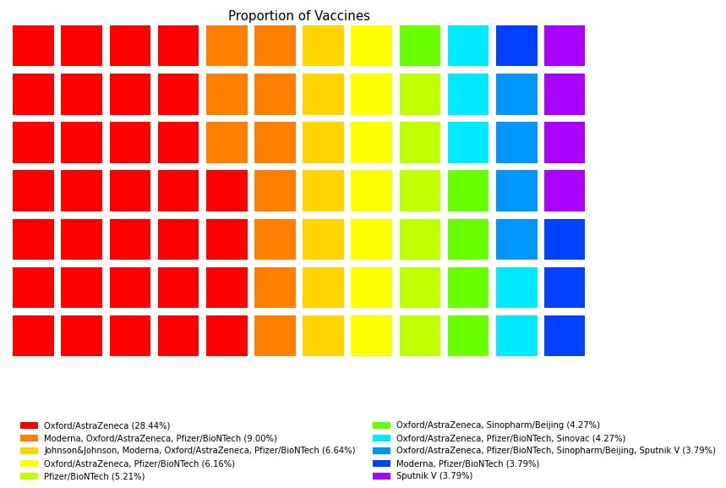
Exploratory Data Analysis

Slide 7
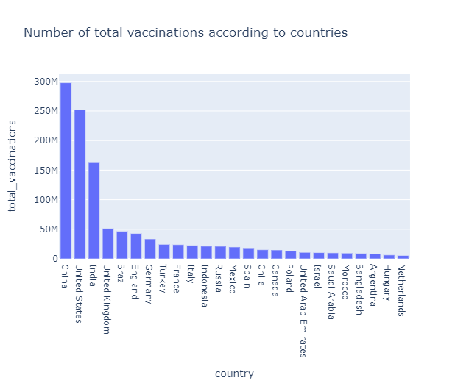
Data Visualization
data = new_df[['country','total_vaccinations']].nlargest(25,'total_vaccinations') fig = px.bar(data, x = 'country',y = 'total_vaccinations',title="Number of total vaccinations according to countries",) fig.show()

Slide 8
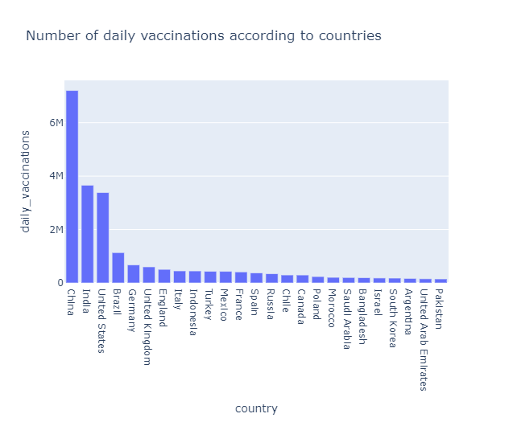
data = new_df[['country','daily_vaccinations']].nlargest(25,'daily_vaccinations') fig = px.bar(data, x = 'country',y = 'daily_vaccinations',title="Number of daily vaccinations according to countries",) fig.show()

Slide 9
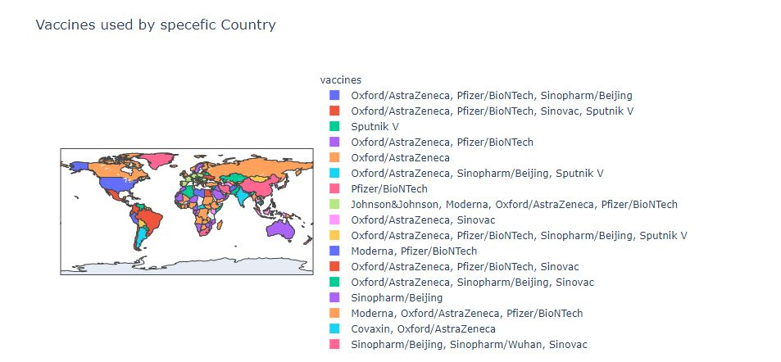
Vaccine is Used the most
Output :

Slide 10
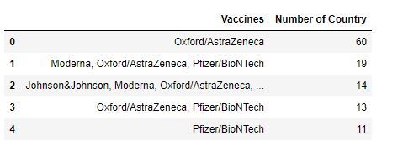
Predictive Modelling - Evaluation
vacc = new_df["vaccines"].unique() for i in vacc: c = list(new_df[new_df["vaccines"] == i]['country']) print(f"Vaccine: {i}nUsed

Slide 11
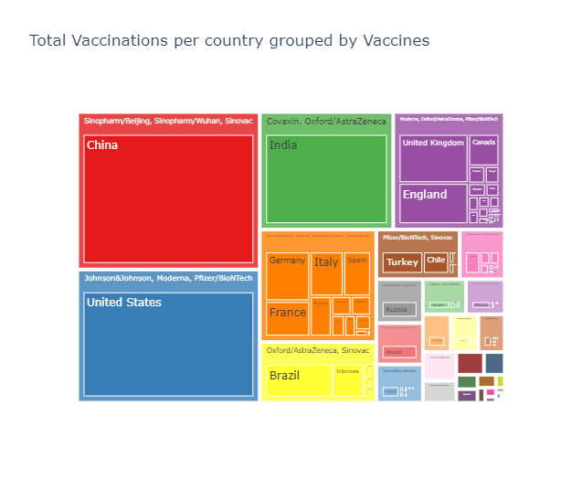
Total Vaccinations

Slide 12
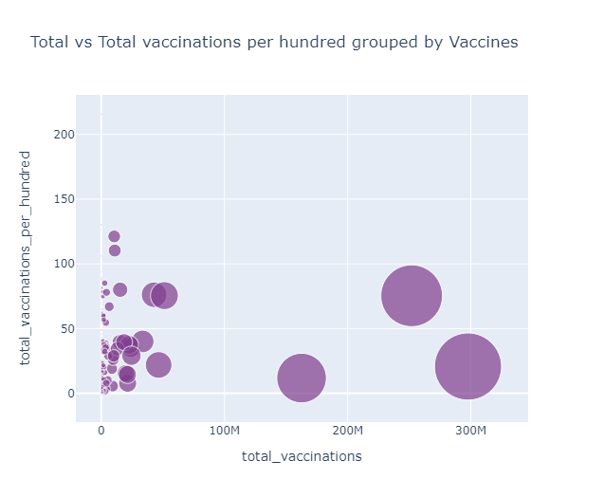

Slide 13
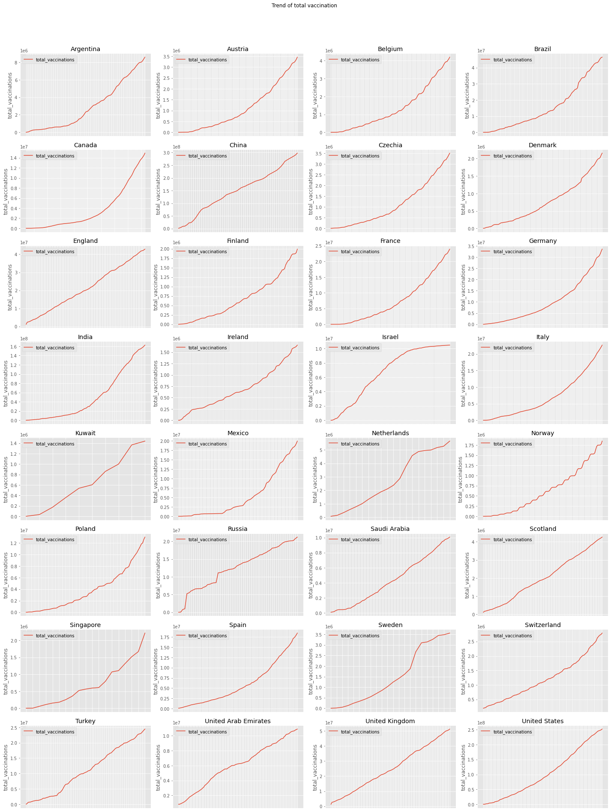
Output :

Slide 14
Conclusion
You can collect the dataset from here and play with it. You may find a difference in the results because every day a lot of people getting infected by Covid19 and the data of covid19 is being changed every day.
At last, I wanna say that we all know that, we are in a very bad situation because of Covid19. All we have is each other so let’s help each other to the best we can & pray for our planet to get well soon.

